Slide 1
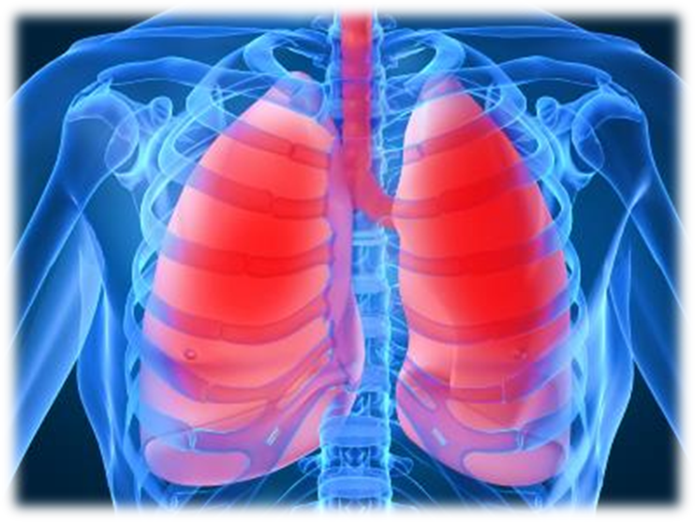
Major Case Study: COPD
Emily Brantley
Dietetic Intern
Andrews University

Slide 2
Introduction
Patient’s Initials: NM
Primary Problem & other medical conditions:
COPD, DM, IBS, Pneumonia, IgA deficiency
Height: 160.02
Weight: 107.2
Age: 62 years old
Sex: Female

Slide 3
Introduction
Reason patient was chosen for case study:
NM was chosen because of the multiple complications that she faces.
Date the study began and ended
December 5, 2013 – December 6, 2013
Focus of this study:
Chronic Obstructive Pulmonary Disease (COPD)
NM has other comorbidities, however, NM is most often admitted to the hospital for exacerbation of COPD.

Slide 4
Social History
NM is a Christian woman who lives at home with her husband and pet parakeet.
She is currently on Medicare.
Retired RN.
Her three children are all adults and live within the region.
NM is a former smoker
Medical records indicate that she does not smoke or drink alcohol anymore.

Slide 5
Normal Anatomy and Physiology of Applicable Body Functions
COPD is characterized by slow, progressive obstruction of the airways.
There are two physical conditions that make up COPD.
Emphysema
Characterized by abnormal, permanent enlargement and destruction of the alveoli
Chronic Bronchitis
A progressive cough with inflammation of bronchi and other lung changes
Frequently, both illnesses coexist as part of this disorder.
In both cases, the disease limits the airflow ^{1&2}

Slide 6
COPD

Slide 7
Past Medical History

Slide 8
Past Medical History
NM initially received the diagnosis of COPD in 1997.
American Thoracic Society states comorbidities such as cardiac disease, diabetes mellitus, hypertension, and psychological disorders are commonly reported in patients with COPD, but with great variability in reported prevalence.

Slide 9
Past Medical History
Pneumonia
NM has been hospitalized six times within the past year for episodes of pneumonia.
COPD is more frequently associated with pneumonia.
Corticosteroids are standard of care for acute exacerbations of COPD, but their role in the management of patients with COPD with pneumonia is less defined. ³
Diabetes Mellitus.
The evidence for an interaction between diabetes and COPD is supported by studies that demonstrate reduced lung function as a risk factor for the development of diabetes.
Smoking has been established as a risk factor for both COPD and Diabetes Mellitus. ³
Gastro-esophageal reflux disease (GERD).
An increased prevalence of GERD has been reported in patients with COPD. A study of 421 patients with severe COPD using 24-hour esophageal pH monitoring showed that 62% had pathological GERD, and 58% of the patients reported no symptoms of GERD.³

Slide 10
Past Medical History
Bronchial Asthma
Adrenal Insufficiency
Coronary Artery Disease
Trachaeomalacia
Addison’s disease
Hypothyroidism
Bipolar Disorder
Irritable Bowel syndrome
Vascular stent placement
Hyperlipidemia
Hyperthyroidism
Anemia

Slide 11
Present Medical Status and Treatment

Slide 12
Theoretical Discussion of Disease Condition
COPD is the fourth leading cause of death in America. COPD is also more prevalent in women.^{3&4}
The primary risk factor in the development of COPD is smoking.
Beyond the cessation of smoking, it has been shown that the inflammatory stress continues to damage the lung tissue.
Other risk factors include air pollution, secondhand smoke, history of childhood infections, and occupational exposure to certain industrial pollutants.

Slide 13
Theoretical Discussion of Disease Condition
Although normal lung function gradually declines with age, individuals who are smokers have a more rapid decline—twice the rate of nonsmokers.
Low body weight has also been shown to be a risk factor for the development of COPD even after adjusting for other potential risk factors including smoking and age.²
Malnourished patients with COPD experience worsened respiratory muscle strength, decreased ventilator drive and response to hypoxia, and altered immune function.^{1,5&6}

Slide 14
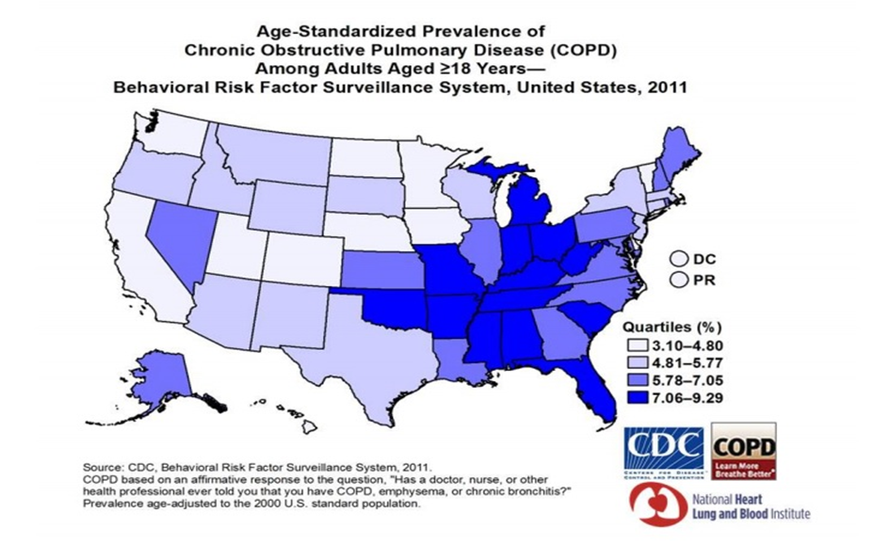

Slide 15
Usual Treatment of the Condition
An early and accurate diagnosis of COPD is the key to treatment.
Quitting smoking is the single most important thing that can be done to help treat COPD.⁷
The usual treatment of COPD is composed of four main goals for effective management:
1. Assess and monitor the disease
2. Reduce risk factors
3. Maintain stable COPD and respiratory status
4. Manage any exacerbations
Once the disease progresses, rehabilitation programs along with oxygen therapy are used as treatment.
Medications include bronchodilators, glucocorticosteroids, mucolytic agents, and antibiotics to treat infections.
In cases where COPD may be advanced, there is an option for surgical intervention, such as a lung transplant.¹

Slide 16
Patient’s Symptoms upon Admission Leading to Present Diagnosis
NM was admitted with shortness of breath, cough, diarrhea, hypokalemia and fever.
She revealed that one of the possible causes of her diarrhea may be the fact that she had “been around a couple of people with Clostridium Difficile.”
NM also showed symptoms of hyperlipidemia and hypertension
High blood pressure is a complication of COPD.⁶
Hyperglycemia is a side effect of steroid therapy for COPD.
Steroids can increase the blood sugar making diabetes harder to control.⁸

Slide 17
Laboratory Findings and Interpretation

Slide 18
Current Medications
Depakote ER (Valproic Acid)
Lexapro (Escitaloprem)
Florinef (Fludrocortison Acitate)
Fluticasone- salmeterol
Metronidazole Flagyl
Insulin Lispro (Humalog)
Misoprostal (Cytotec)
Monelukast (Singulair)
Pantaprazole (Protonix oral)
Potassium Chloride
RisperiDONE (RisperDAL)
Rosuvastatin (Crestor)
NaCl
Tolterodine
Voriconazole

Slide 19
Observable Physical and Psychological Changes in Patient
NM physically looked well nourished.
She did not appear to have difficulty breathing until after she spoke for a long period of time.
She did have a severe cough that she tried to conceal.
NM was a very agreeable patient for both psychological interviews.
In spite of her COPD diagnosis and all of the multiple medical comorbidities that NM faced, she still presented a positive attitude and spoke openly about her faith.

Slide 20
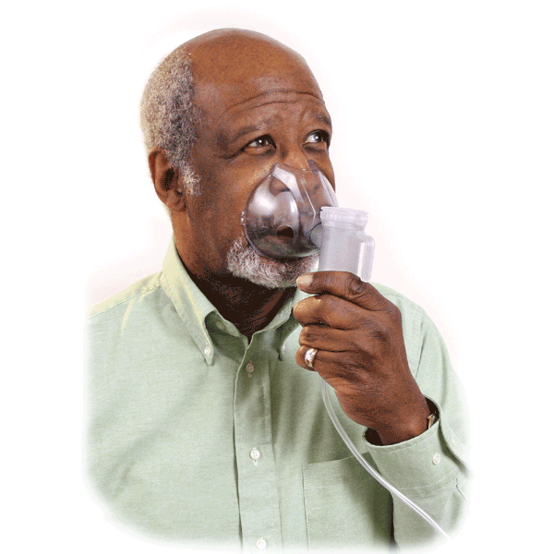
Treatment
NM received a chest x ray that revealed consolidation in the left lung and midline lung level.
Once this was identified, she was admitted to the hospital from the Emergency room for treatment.
She was started on IV steroids, IV antibiotics, flagyl and nebulizers around the clock to see how she progressed.

Slide 21
Medical Nutrition Therapy

Slide 22
Nutrition History
Beginning in March 2012, NM began intentionally losing weight by following a PCP prescribed commercial diet known as Optifast.
Optifast offers shakes, protein bars and soups.
With this regimen, NM has lost 70 pounds since March 2012.
At home, NM usually sticks to her Optifast food items for breakfast, lunch and snacks between meals.
For dinner, she shares a meal with her husband.
He is a professional chef who is control of purchasing groceries and prepares dinner most nights.

Slide 23
Analysis of Previous Diet: 24 hour recall

Slide 24
Current Prescribed Diet
NM was on steroid therapy to treat her COPD.
Because of the steroid therapy, NM was admitted with consistently high blood glucose levels.
For this reason, doctor’s orders were given for an Average Diabetic Diet for the duration of her stay at Winter Park Memorial Hospital.
An Average Diabetic Diet provides a consistent 60-75 grams of carbohydrates for each meal.
NM’s diet order remained the same for her entire stay.

Slide 25
Objectives of Dietary Treatment
The objective of the Average Diabetic diet is to maintain NM’s blood sugars within normal limits or as close as possible to normal levels.
Steroid therapy that NM was undergoing to treat her COPD helps keep blood sugars high
Finger-stick blood sugar levels referred to as “Accuchecks” ranged inconsistently from 130 to 289 as seen on the lab values table above.

Slide 26
Patient’s Physical and Psychological Response to Diet
At home, NM followed an eating pattern similar to that of the Average Diabetic Diet but with the addition of snacks in between meals.
She denied facing vomiting or constipation while on this diet.
She did admit to experiencing diarrhea and nausea upon admission to the hospital.
As previously mentioned, NM believed she was exposed to Clostridium Difficile, to which she attributes to the cause of having diarrhea.

Slide 27
List nutrition-related problems with supporting evidence
COPD: Increased energy expenditure related to increased energy requirements during COPD exacerbation as evidenced by measured resting energy expenditure greater than predicted needs.

Slide 28
Evaluation of Present Nutritional Status
According to the diet analysis table, NM was meeting her increased caloric needs for COPD.
Her diarrhea subsided by day two of hospitalization.
Per lab values as those noted above in the table, there did not appear to be any indication of dehydration.

Slide 29
Calorie and Protein Guidelines
Nutritional needs are often increased in COPD due to the increased work of breathing.
Optimal nutritional status plays an important role in maintaining the integrity of the respiratory system and in allowing maximal participation in daily living.¹
Caloric requirements for COPD individually determined based on:
Patient age, weight and gender, the extent of protein energy malnutrition loss of lean body mass, current medications and other acute or chronic medical conditions.
The Mifflin St. Jeor equation may underestimate the caloric requirements of patient’s with COPD because of the caloric increase from metabolically active tissue.
To compensate for this underestimation, a stress activity factor may be added according to the degree of stress.
In most cases the total calorie intake of the COPD patient is more important than the source from calories.

Slide 30
Calorie and Protein Guidelines
For maintenance 1.33 x REE or 25/35 calories per kilogram is appropriate for the needs of the COPD patient.
Protein is recommended at 1.0-1.5 grams per kilogram of body weight for maintenance.¹
Below is a chart of how NM’s needs were clinically calculated during her hospital admission on December 5th through the 6th.

Slide 31
Need for Alternative Feeding Methods and the Patient’s Nutrition Education Process
NM was in fact meeting the additional needs required for COPD, I do not believe that there was any need for alternative feedings such as tube feeding.
Moreover, in explaining the prescribed diabetic diet to NM, no type of barrier to learning was identified.

Slide 32
Prognosis

Slide 33
Prognosis
NM expressed her motivation to continue to follow a diet similar to that of the Average Diabetic Diet upon her return home as long as her increased COPD needs were met.
She was aware of the effects of steroid therapy on her blood sugar levels.
NM clearly verbalized her understanding on the use of steroids, their effects on increasing blood sugar levels and the importance of meal planning especially around carbohydrates.
This was more of a motivating factor for her to continue monitoring her diet on discharge.

Slide 34
Summary

Slide 35
Summary
From this study, I learned how very serious COPD is.
It was once explained to me some time ago that COPD was like a gradual suffocating in a pillow.
Seeing NM experiencing shortness of breath during the interviews or when speaking to me during the interviews made me realize that even the slightest amount of energy requires oxygen.
Imagine not being able to breathe to conduct the simplest activities of daily living!
In addition to other medical issues as NM had, it made me realize how important nutrition energy is needed for healing.

Slide 36
Questions?

Slide 37
Thank You! ☺

Slide 38
References
Mahan LK, Escott-Stump S, Raymond JL. Krause’s Food, Nutrition and Diet Therapy, 13th Edition, Philadelphia, Pa: Elsevier; 2012
Nelms M, Sucher KP, Lacey K, Roth SL. Nutrition Therapy and Pathophysiology, 2nd Edition. Cengage Learning, Inc: 2010.
Chatila WM, Thomashow BM, Make BJ. Comorbidities in Chronic Obstructive Pulmonary Disease. Journal of the American Thoracic Society. 2008 May 1; 5(4): 549-555
Centers for Disease Control. Chronic Obstructive Pulmonary Disease (COPD) Data and Statistics. Available at: http://www.cdc.gov/copd/data.htm. Accessed December 29, 2013.
American Society for Parenteral and Enteral Nutrition. Disease-Related Malnutrition and Enteral Nutrition Therapy. Available at: http://www.nutritioncare.org/index.aspx?id=5696. Accessed January 5, 2014.
Mayo Clinic. Disease and Conditions: COPD. Available at: http://www.mayoclinic.org/diseases-conditions/seo/basics/symptoms/con-20032017. Accessed January 8, 2014.
National Institutes of Health: National Heart Lung and Blood Institute. How Is COPD Treated? Available at: http://www.nhlbi.nih.gov/health/health-topics/topics/copd/treatment.html. Accessed January 8, 2014.
British Lung Foundation. Steroids. Available at: http://www.blf.org.uk/Page/Steroids. Accessed December 29, 2013.
MedlinePlus: A service of the U.S. National Library of Medicine From the National Institutes of Health National Institutes of Health. Drugs and Supplements. Available at: http://www.nlm.nih.gov/medlineplus/druginfo/drug_Ca.html
U.S. National Library of Medicine. Drug Information from the National Library of Medicine. Available at: https://www.nlm.nih.gov/learn-about-drugs.html. Accessed January 8, 2014.
Optifast. Product Information. Available at: http://www.optifast.com/Pages/index.aspx. Accessed January 7, 2014

Slide 39
References: Images
http://sciencelife.uchospitals.edu/2013/05/07/qa-dr-christopher-wigfield-on-the-future-of-lung-transplantation/
http://www.guidantwealth.com/Goal-early-retirement.html
http://www.recessionista.com
http://www.everydayhealth.com
https://www.spiriva.com/?sc=SPRACQWEBPGOGBS1105034&utm_source=google&utm_medium=cpc&utm_term=spiriva&utm_campaign=Branded&MTD=2&ENG=1
http://www.nlm.nih.gov/medlineplus/ency/imagepages/19376.htm
http://www.cdc.gov/copd/data.htm
http://www.www.kingcounty.gov
http://www.www.anactivelife.com
http://www.optifast.com/Pages/index.aspx
www.fairmed.at
www. Eatright.org
http://www.alltheweigh.com

